Slide 1
Katyń 80th anniversary The crimes of Soviet Russia committed against Poles in 1937-1941
Created by:
Andrzej Burghardt
Zbigniew Koralewski
Krzysztof Wąż
© COPYRIGHT 2022 Coalition of Polish Americans
(applies only to altering of this material, but not to free distribution)

Slide 2
Knowledge of the history of Poland, including its tragic side, of which Katyń is a significant symbol, is an extremely important element of Polish and Polonia’s national consciousness. For a numer of reasons, the history of Poland, especially the period of World War II, is often incomplete and deliberately distorted in US media, entertainment, politics and schools. Our duty is to learn the truth about these horrific events.

Slide 3
This presentation will acquaint you with:
The genocidal nature of the „Polish Operation”, which the Soviets carried out in 1937-1938;
Anti-Polish German-Russian treaty of August 23, 1939, and their attack against Poland from all directions in September 1939, which started the World War II;
Extermination of the Polsish people by Germans and Russians;
Katyń Massacre as a specific case of the continuing Soviet genocide of Poles;
Soviet ethnic cleansing: deportation of about 1-2 millions of Poles to Siberia;
Hiding and falsifying the truth about the Katyn genocide and deportations.

Slide 4
The Polish Operation by NKVD in 1937
The “Polish Operation” was carried out by the NKVD (communist political police, infamous for terror and cruelty) two years before the Second World War. It consisted of severe persecution of persons of Polish origin who lived within the Soviet Union, as a part of an ethnic cleansing plan.
According to Soviet documents, almost 240,000 people were imprisoned in 1937 alone, of which almost half were murdered, the rest were sent to labor camps or deported to Kazakhstan and Siberia. In the following year, the numbers of victims were similar.

Slide 5
Victims of the NKVD “Polish Operation”
The action covered all persons suspected of Polish ethnicity. Poles were killed or deported for only one reason: because they were Poles. Poles, more than other nationalties, were considered potential enemies of the Soviet system.
This began a pattern of persecution that continued in occupied Poland after the Soviet invasion of September 17, 1939. It is estimated that the Soviets committed such crimes against Poles in about 800 places.

Slide 6
A treaty signed between Soviet Russia and Nazi Germany, and its secret part
A week before the attack on Poland, in August 1939, the foreign ministers of Russia and Germany signed an agreement known as the
Molotov-Ribbentrop Pact.
It contained a secret protocol about the planned attack and the subsequent partition of Poland.

Slide 7
Another partition of Poland, a mere 20 years after regaining freedom
In order to facilitate their planned aggression of Poland, the Germans formalized friendly relations with Russia and signed an agreement on non-aggression and subsequent partition of Poland. Jozef Stalin, the dictator of communist Soviet Union, can be seen in this picture.

Slide 8
German and Soviet Invasion of Poland – Outbreak of World War II
On September 1, 1939, the German armies entered Poland from the west, south and north. On September 17, Russia invaded Poland from the east.
Poland was the only country in the Second World War attacked from all directions by the two most powerful armies in Europe.
In addition, Poland was attacked from the inside by German saboteurs, the so-called „fifth column”, whose task was to cause chaos and thus obstruct defense.

Slide 9
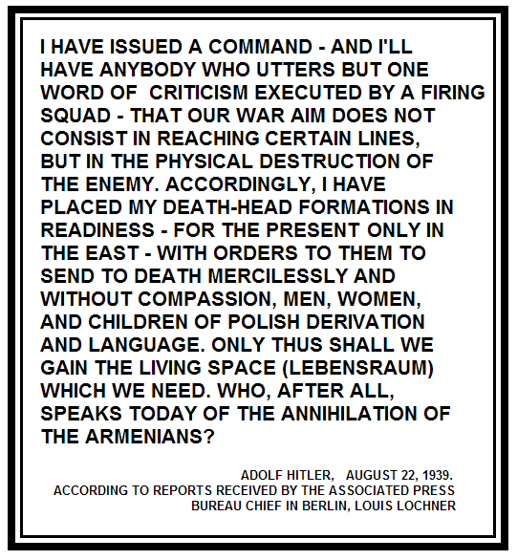
Excerpt from Adolf Hitler's shocking speech to German military commanders.
Report of Hitler's speech, which can be viewed in the Holocaust Memorial Museum in Washington, DC

Slide 10
German and Soviet Invasion of Poland – Outbreak of World War II (continued)
The day of Germany's attack on Poland, September 1, 1939 is considered the beginning of the World War II.
The United States entered World War II two years later, after Japan's attack on Pearl Harbor on December 7, 1941.

Slide 11
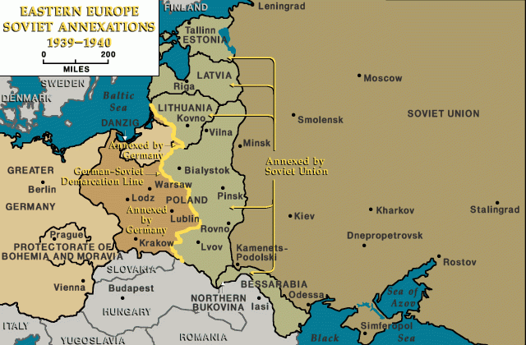
The new partitioning of Poland between Germany and Soviet Russia

Slide 12
Extermination of the Polish people: the primary purpose of the „Treaty of Friendship” between the aggressors
After the partitioning of Poland, Russia and Germany signed the "Treaty of Friendship" in which they undertook to cooperate closely in the liquidation of the Polish people.
The Germans began the extermination of teachers, professors, clergy, officials, physicians - that is, the most educated part of society, the patriotic elite, in order to prevent the rebirth of the Polish state and the organization of a resistance movement.
They arrested selected people, whom they tortured during interrogations or immediately sent to concentration camps, where most of them died in a few months due to starvation, illness or excessive forced labor.
The Auschwitz concentration camp was created solely for Poles at first.

Slide 13
„Treaty of Friendship” between the aggressors (continued)
The Germans also organized round-ups (manhunts) in the streets and performed public executions to intimidate and terrorize society. Thousands of people, whole families, including children, were transported to Germany for slave labor.
The Soviets had their own methods of destroying the Polish people in the territories they occupied:
they secretly carried out mass executions and deported Poles to Siberia.

Slide 14
Katyń
Have you heard the name Katyn?
Do you know where Katyn is located?
What happened in Katyn? When?
What does the name “Katyn” connotate for Poles?
Have you heard about any Katyn monuments, or seen any?

Slide 15
Murdering prisoners-of-war and prominent civilians at Katyn… and other places
One of the top Soviet goals was the extermination of Polish army officers and anyone the Soviets considered influential to the societal integrity of Poland and to Polish national identity. In April and May of 1940, the Soviets killed 22,000 people in several places in Russia, with a shot in the back of the head. Only one such place was discovered 3 years after the crime (near the village of Katyń, near Smolensk, in present day Russia) and became known to the world as the place where the Katyn Crime had been committed.
Other locations were identified only after the collapse of the Soviet Union, and some have not been identified to this day..

Slide 16
Murdering prisoners-of-war and prominent civilians at Katyn and other places (continued)
Most of the victims of the crime were officers and soldiers of the Polish Army.
The murder of thousands of soldiers, held by the Soviets as prisoners-of-war, at a time when there were no military actions between Poland and Soviet Russia, was an unprecedented crime of its kind in the 20th century, violating international laws.
This was an act of genocide, too.

Slide 17
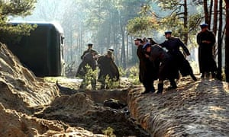
A scene from the movie „Katyn” by Andrzej Wajda

Slide 18
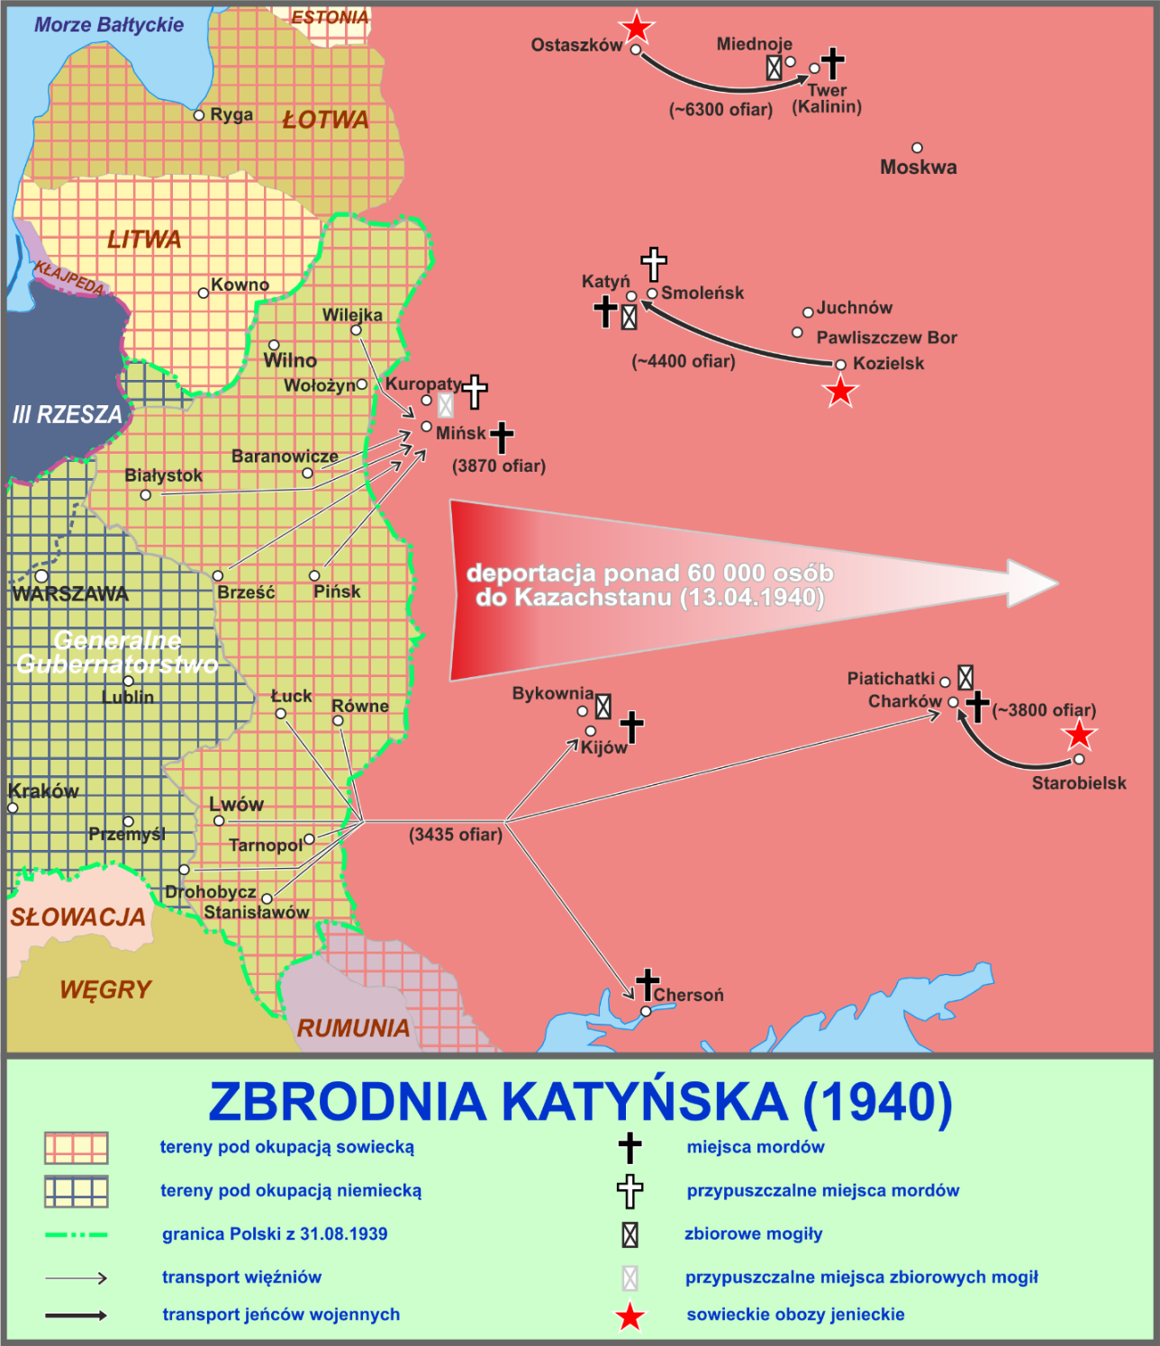
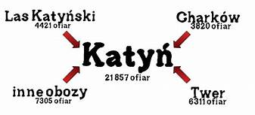
The map and diagram of the Katyn Crime

Slide 19
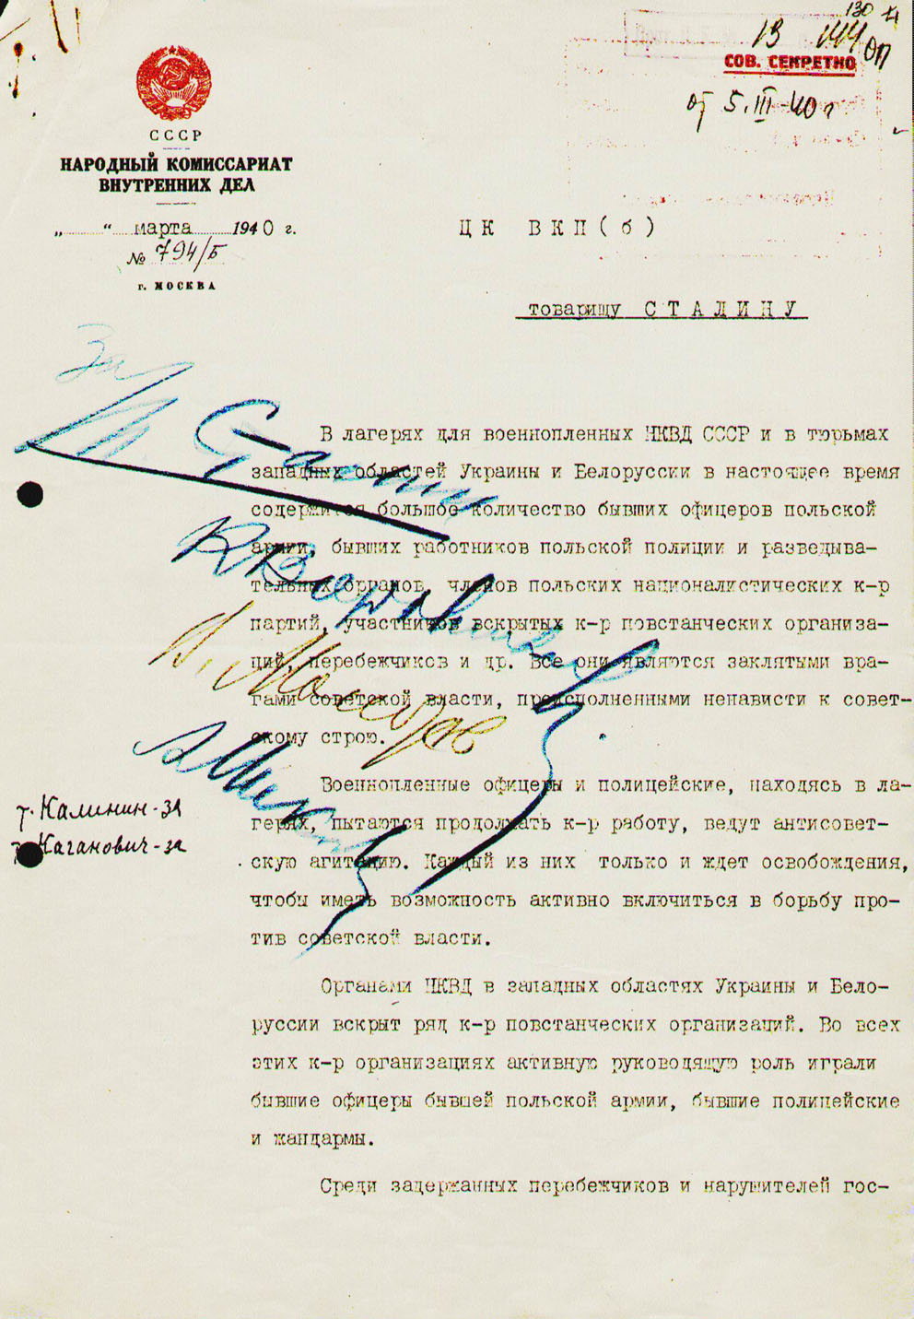
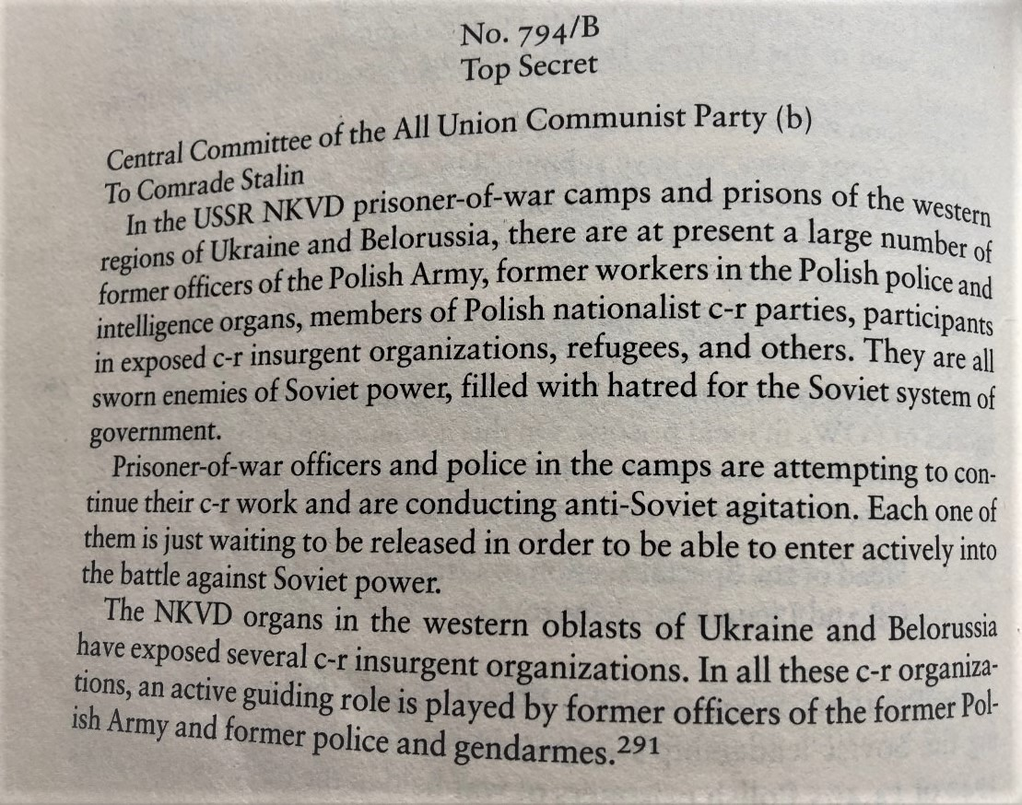
The decision to shoot prisoners of war signed by Stalin and his associates Voroshilov, Molotov and Mikoyan. Annotations on the margin testify that Kalinin and Kaganovich also supported this decision.

Slide 20
Why did Stalin murder prisoners-of-war?
Communist (extreme left) governance bases its power on zero tolerance of opposition, deceit, fomenting a culture of betrayal, fear, terror, and ultimately elimination of any opponents.
Both Stalin and Hitler felt themselves to be unaccountable. They believed that their actions could be hidden, falsified, minimized… being certain of never having to face responsibility for their actions.
The desire to take revenge on the Poles for the victorious repulsion of Soviet Russia's aggression in 1920, preventing the Bolsheviks’ march to the West and the imposition of communism on all of Europe, very likely played a role.

Slide 21
Discovery of the Katyn graves
The Germans were informed about the graves by the local population at the beginning of 1943. On April 13, the German radio broadcast a message about the discovery of mass graves in which the bodies of missing Polish officers were found.
A few days later, radio Moscow broadcast a message that it was merely German propaganda and that it was the Germans who committed the crime. Sadly, U.S. President Roosevelt and British Prime Minister Churchill remained silent.
The facts presented caused great consternation among the Western Allies, possibly threatening to damage their alliance with Soviet Union because the crimes were committed on the allied Polish soldiers.

Slide 22
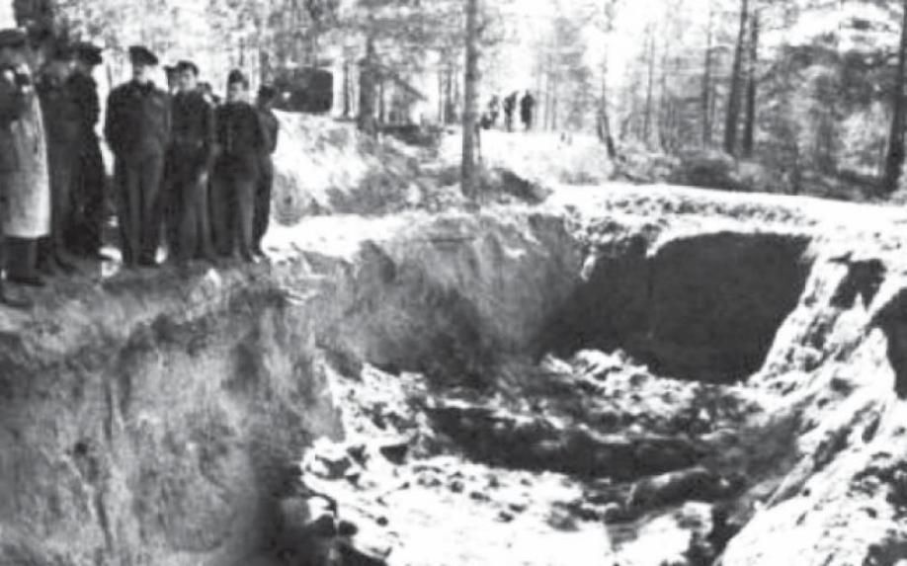
One of the eight death pits in Katyn

Slide 23
The history of Poland is marked by graves… There has never been such a grave yet. (words uttered on May 14, 1943 by Wacław Lachert, president of the Board of the Polish Red Cross during the exhumation, to which the Germans invited representatives of that organization)
In order to prove that it was the Russians who murdered Polish soldiers, the Germans invited representatives of the Allies and many other countries to inspect the crime scene.
The 10-person Polish Red Cross delegation agreed to cooperate in the exhumation. Under the supervision of the Germans, the recovered bodies were placed on stretchers and searched meticulously for all documents: notes, diaries, wallets, photos and even parts of uniforms, and then the bodies were buried in new common graves. All important materials were put into envelopes and secured in 14 boxes. They constituted valuable evidence. Its extraordinary fate is described by Allen Paul in his book „Katyn”.
From these notes and diaries we know how the Poles were deceived: they were told that there would be an exchange of prisoners. The soldiers were glad that they would soon be free. Before they were transported from the camp to the Katyn forest, they were given extra food rations. They were allowed to keep their personal belongings.

Slide 24
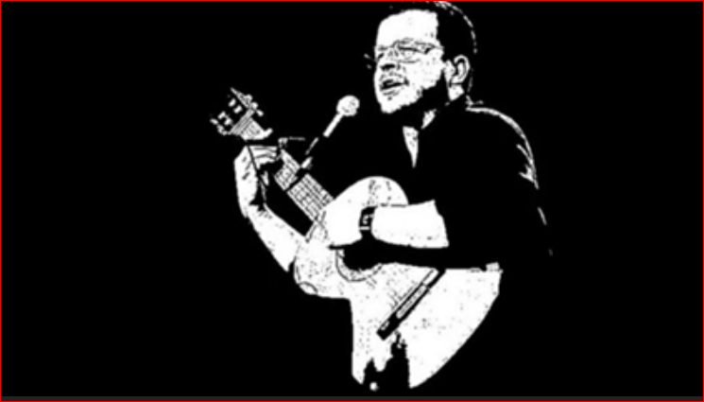
The Ballad of Katyń – Jacek Kaczmarski Two renditions of the song by the author
← Here the song is illustrated by filmed
documentary of the Katyn exhumation in 1943.

Slide 25
Deportations to Siberia
Between February 1940 and June 1941, the Russians carried out four rounds of deportation of Poles from the occupied Polish territories, deep into the Soviet Union. During the year, about 1.1 million Poles, whole families with children, were deported to Siberia and Kazakhstan, to the "inhuman land".
Among the first victims of the deportation – a multi-day journey in freight rail cars, unheated and in inhuman conditions – were the families of prisoners murdered in Katyn.
Poles were deported with the intent that they never return from Siberia… that they would die there of hunger, desease and harsh weather.

Slide 26
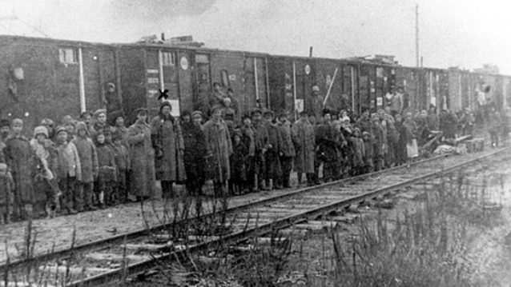
„Sybiraks” – Poles exiled to Siberia 10.02.1940 – First wartime deportation of Poles to the east of the Soviet Union (belsat.eu)

Slide 27
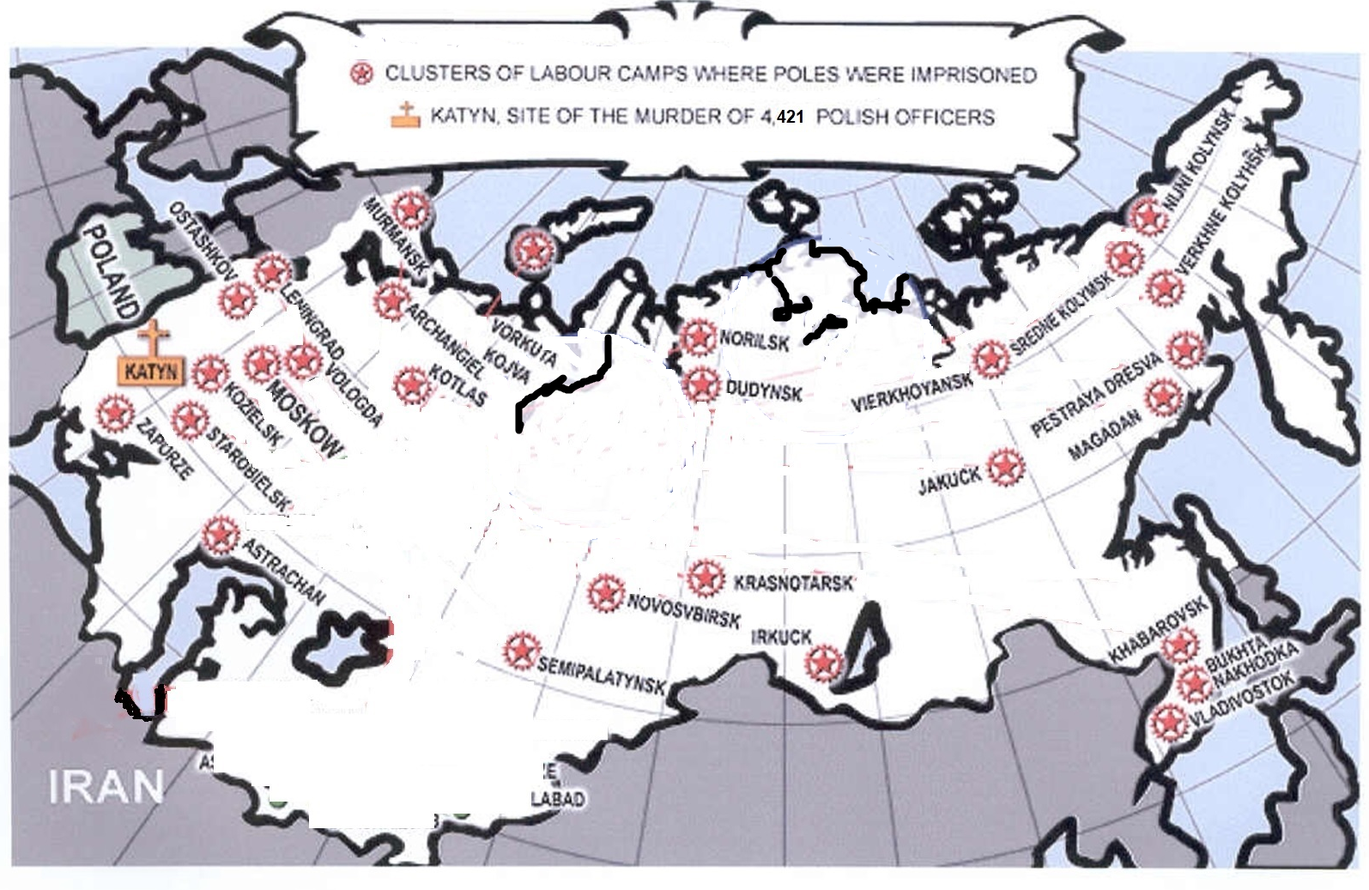
Places where Poles were deported

Slide 28
Realities of deportations
Account of the first deportation::
The deportation carried out by the NKVD on February 10, 1940 took place in terrible conditions, which for many meant a death sentence. During its implementation, the temperature was as low as -40⁰C.
The deported people were allowed less than one hour to pack up. In many instances, people were not allowed to take anything with them at all.

Slide 29
Realities of deportations (continued)
A teenage boy from Dubno county in Volhynia gives this account of the invasion of their house by Soviet functionaries (from the book "In the fortieth, Mother, to Sibir they sent us”, Poland and Russia 1939-1942:
NKVD barged into our house like a pack of wolves, with nagans and daggers, and proceeded to destroy holy pictures, break furniture, while calling us names like „the Polish bourgeois”. They kept a watchful eye on my father, and they kept asking about weapons that Daddy didn't have, so they proceeded to tear boards from the floor, throw clothes out of wardrobes, break beds. After our house had been destroyed for an hour, we were ordered to gather; we were allowed to take some clothes and only 5 kg of flour, although 5 of us were deported. Like prisoners, we were led under nagans to a sleigh and driven as a laughingstock through the town to the railroad station.

Slide 30
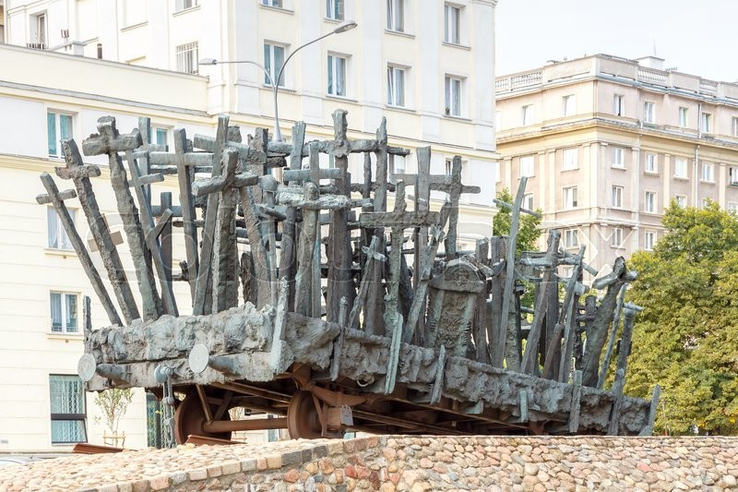
Monument to the Fallen and Murdered in the East erected in Warsaw on 17 September 1995
It commemorates the victims of the Soviet invasion of Poland during World War II and subsequent repressions.

Slide 31
Concealing and falsifying the truth about deportations of Poles to Siberia and the Katyn Massacre
The Communist government imposed on Poland by the Soviets after World War II for 45 years concealed and distorted information anout the Katyn massacre and deportations to Siberia. With terror, they achieved that Poles after the war were afraid to even utter the word Katyn or talk about Soviet crimes.
Meanwhile, much was said (rightfully) about German crimes, especially against Jews, just as it is today.

Slide 32
Concealing and falsifying the truth about Poles' deportations to Siberia and the Katyn Massacre (cont.)
The Katyn Massacre still remains an untried and unpunished crime. For many years the truth about it was hidden by United States and Great Britain, erstwhile allies of Stalin. The U.S. Congress recognized the truth about Katyn only after 10 years, and only under pressure from the Polish American Congress (documented by the U.S. Congress Madden Committee).
Even today, the full truth about Katyn is not always admitted. The U.S. Congress continues to refuse to officially classify this crime as genocide, despite the fact that it meets genocide definition adopted by the United Nations in 1949. The U.S. Congress did not commemorate the 80th anniversary of Katyn with the adoption of an appropriate resolution, which was sought by American Polonia.

Slide 33
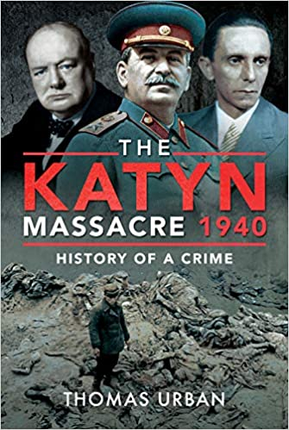
Another example of falsifying the truth about Katyn:
Thomas Urban's book, published on December 28, 2020. The author promotes the view, that the Allies did not know that the Soviets were perpetrators.
On the cover: Churchill, Stalin, and Goebbels
https://www.barnesandnoble.com/w/the-katyn-massacre-1940-thomas-urban/1137594085

Slide 34
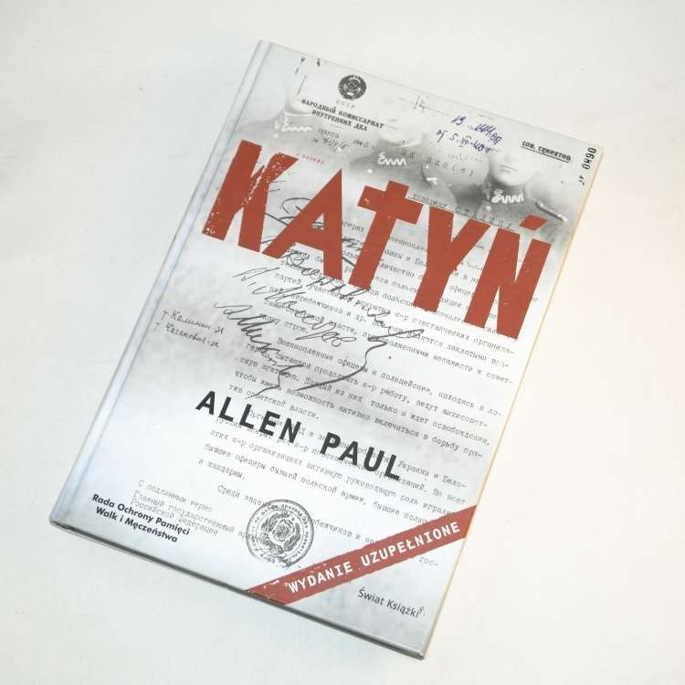
Excerpt from the introduction to the 2006 Polish edition of Allen Paul's book "Katyń" :
“I am an American with no Polish roots, I do not speak Polish […] I took up the case of Katyn, amazed that such a terrible crime is completely unknown in the West. I have found that Poles themselves often have a vague idea of events that can be easily regarded as the Stalinist version of the "final solution" of the Polish issue."

Slide 35
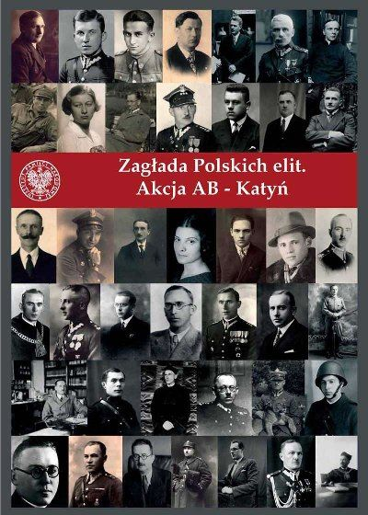
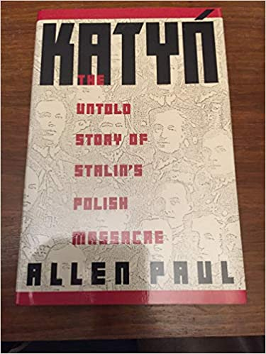

Slide 36
What we have to remember…
The „Polish Operation”, which the Soviets carried out in 1937-1938;
The Ribbentrop-Molotov Pact between Hitler and Stalin, and their aggression of Poland from all directions, which started the World War II;
The Extermination of the Polish people – by both aggressors;
Katyń Massacre, a specific case of the continuing Soviet genocide of Poles;
Soviet Ethnic cleansing: 1-2 million Poles forcefully removed from eastern Poland;
Concealing and falsifying the truth – about Katyn genocide and ethnic cleansing of Poles, by Communists as well as in the West, even today.

Slide 37
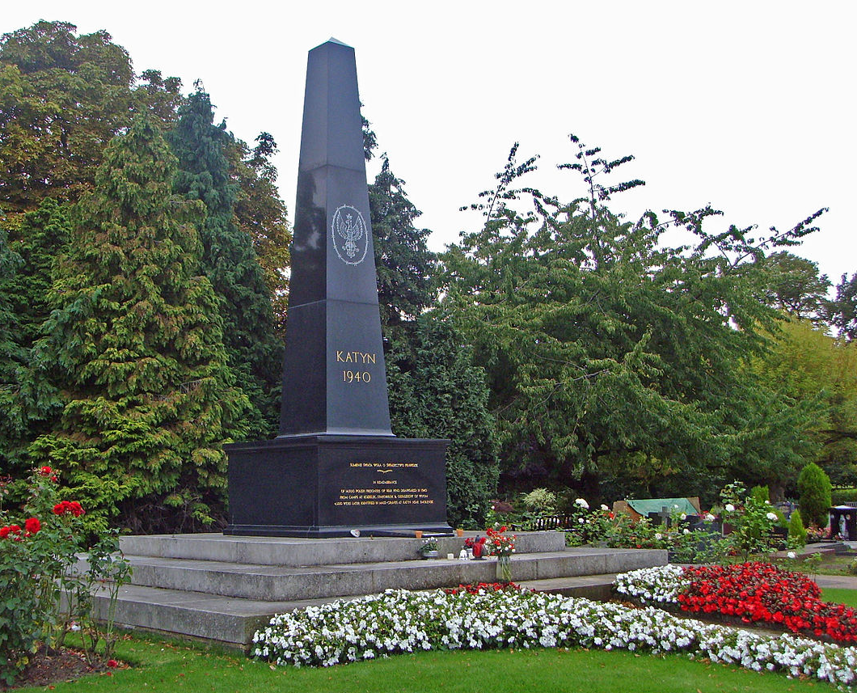
Monuments commemorating the Katyn Crime
For many years, monuments dedicated to the Katyn Massacre had no chance of being built, even in countries outside of the influence of the USSR.
The first obelisk with the inscription "KATYN 1940" was erected in London's Gunnersbury Cemetery in 1976.
In protest against the boycott of the monument's unveiling ceremony by the British government at the time, the grandson of Prime Minister Churchill wrote a famous open letter accusing the authorities of being afraid to irritate Moscow.

Slide 38
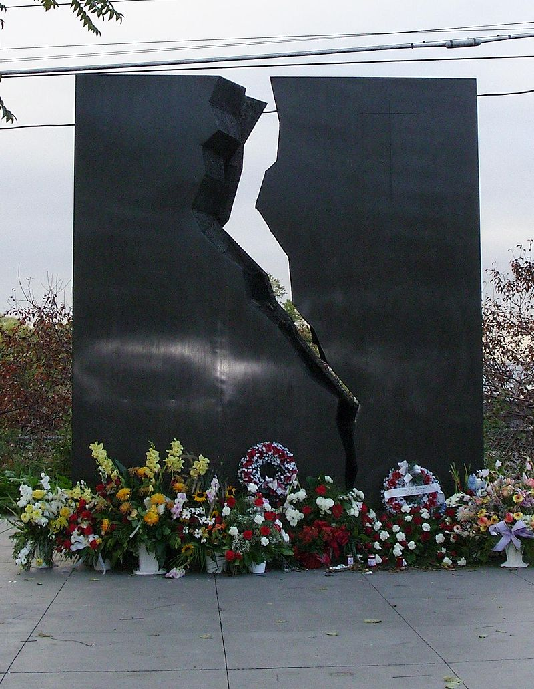
Toronto, Ontario, Canada Unveiled on September 14, 1980
The Toronto Memorial became the world's first Katyn Memorial in a public place in an urban area. It was created thanks to the determination of the Canadian Polish Congress, in particular by Col. Tadeusz K. Wałkowski.
Then Prime Minister of Canada, Pierre Trudeau, fearing Soviet reactions, did not allow two politicians of Polish origin, a senator and a deputy, to take part in the ceremonies on behalf of the government.

Slide 39
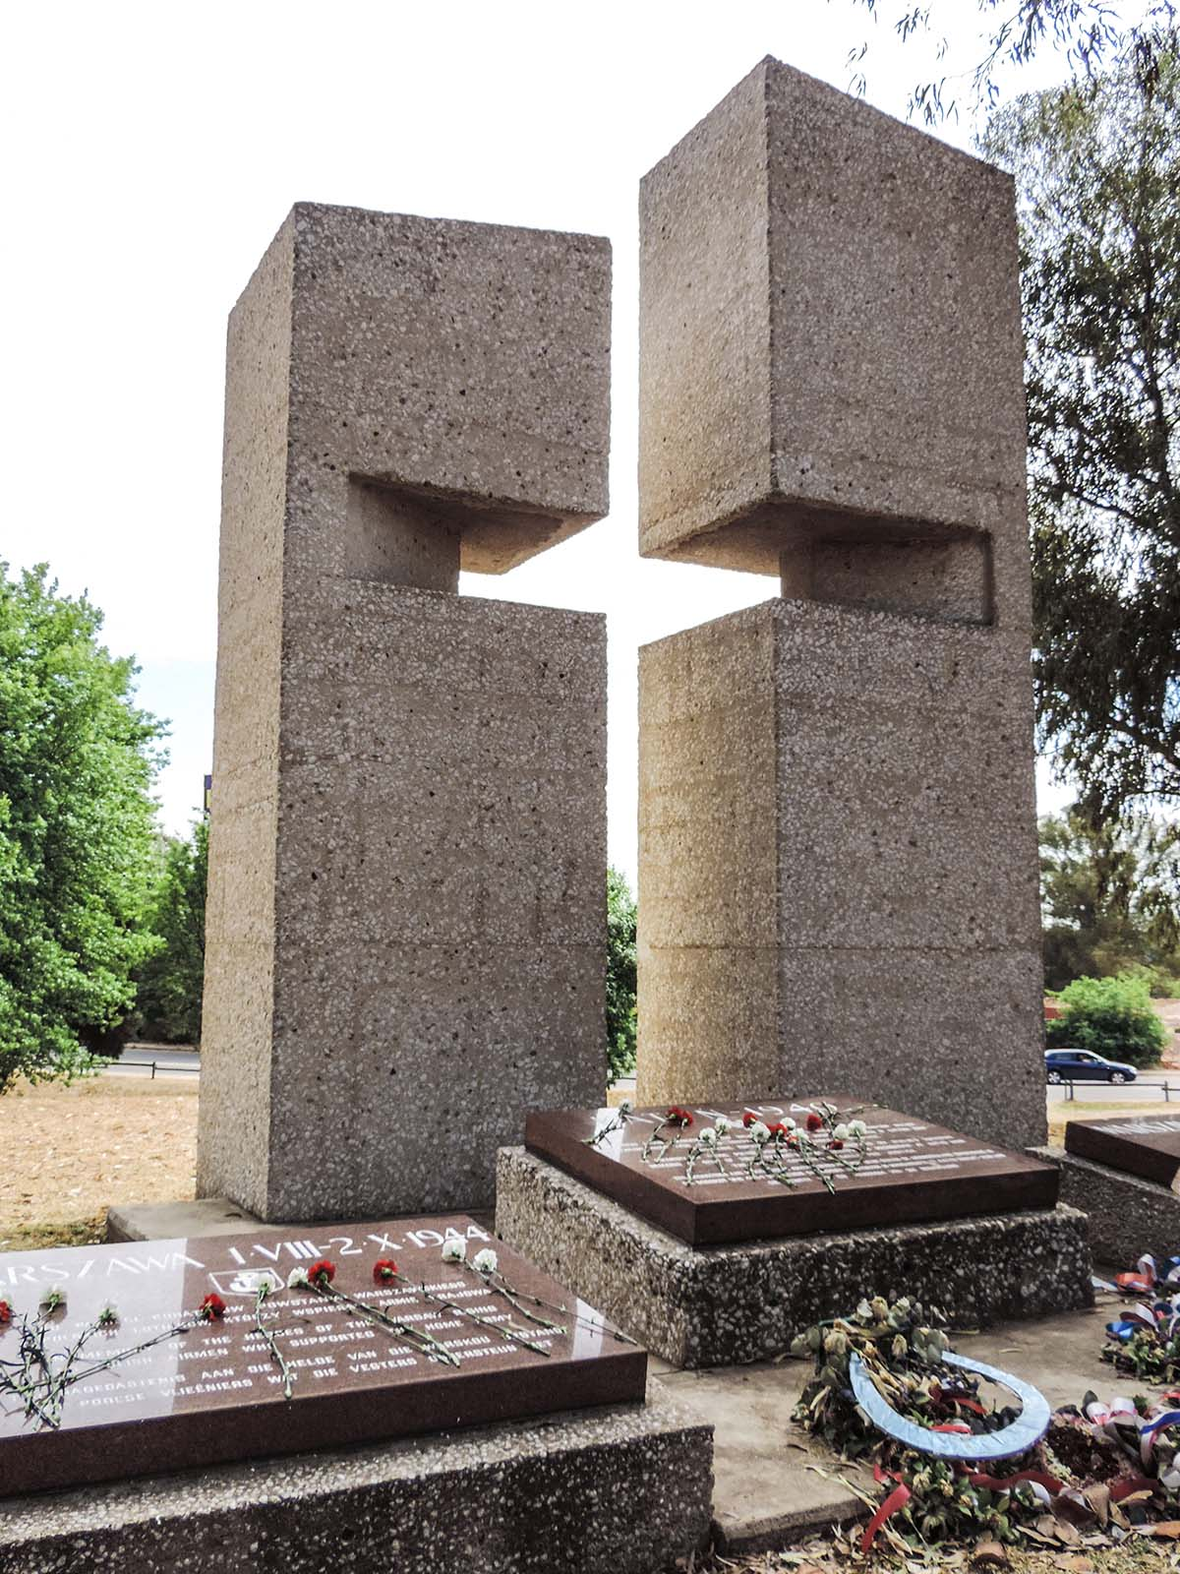
Johannesburg the only Katyn monument in Africa
The monument was created on the initiative of the local Polish community. On May 9, 1981. It was consecrated by a Polish bishop and unveiled, with local Poles and South African authorities attending.
There are two additional plaques on the monument. The first one commemorates 69 South African airmen who lost their lives in 1944 bringing aid to the Warsaw Uprising, and the second one commemorates the soldiers of the Home Army.

Slide 40
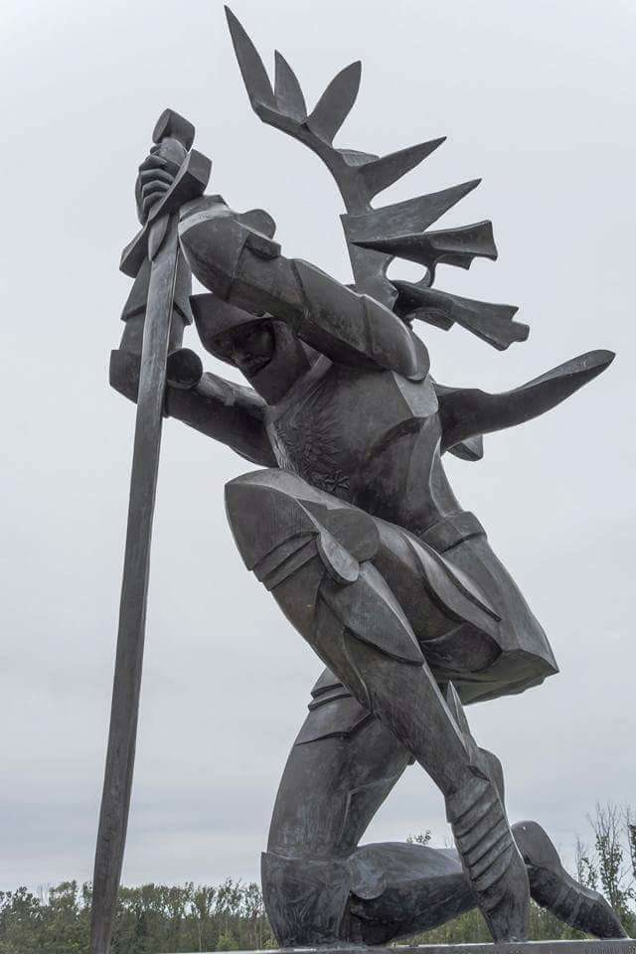
Doylestown, Pennsylvania, USA
Unveiled on August 14, 1988.
The monument created by Andrzej Pityński, about 30 feet high, consists of a granite pedestal and a bronze sculpture of a hussar kneeling on one knee, leaning on a sword.
There are two plaques on the pedestal, the first with the inscription KATYŃ 1940, and the other with the inscription SMOLEŃSK 2010, added in 2011.

Slide 41
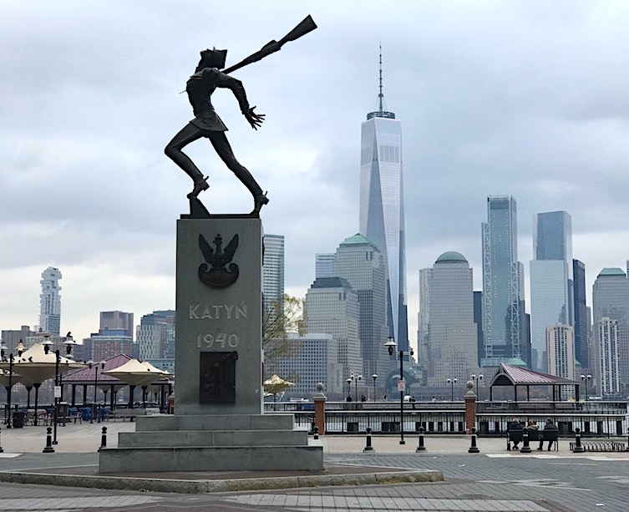
Jersey City,
New Jersey, USA
Unveiled on May 19, 1991
Created by Andrzej Pityński
The first Katyn Memorial in the United States standing in an open urban space on the bank of the Hudson River.
In April 2018, the mayor of Jersey City announced that he intends to create a park in this prominent place, and remove the monument.
This spawned protests of Polonia, supported by other ethnic groups, which resulted in the decision by the City Council to leave the monument with perpetual use rights.

Slide 42
The Katyn Memorial in Jersey City during the terrorist attack on World Trade Center in New York on September 11, 2001
Pictured here are the burning WTC towers on the other bank of the Hudson River, as backdrop of the Katyn Memorial and a crowd of witnesses of this tragedy.
Polish Americans later added a plaque in the base of the Memorial to commemorate the event and its victims.
Fot.: Walter Kowalchouk

Slide 43
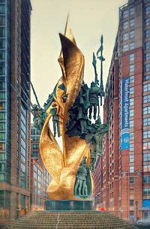
Baltimore, Maryland, USA
Unveiled on November 19, 2000
Created by Andrzej Pityński
The monument, about 60 feet tall, has the form of a bronze sculpture of golden flames with statues of murdered Polish officers composed into it (one of them depicts Lt. Janina Lewandowska, the only woman murdered in Katyn) and select outstanding figures from Polish history:
Bolesław I Chrobry,
Zawisza Czarny of Garbow,
Wladyslaw III Warnenczyk,
Jan III Sobieski,
Tadeusz Kosciuszko,
Kazimierz Pulaski)
and the emblem of Poland

Slide 44
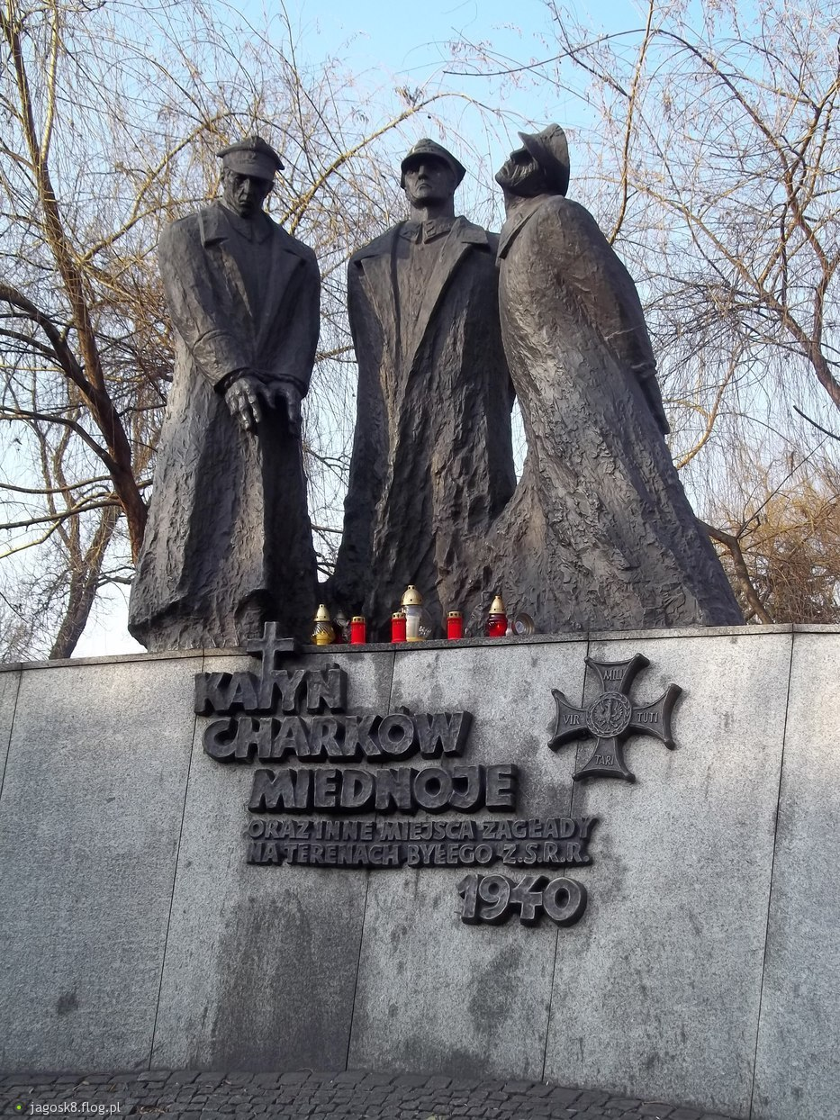
Katowice, Poland
Unveiled on May 24, 2001
The sculpture depicts the Katyn victims: a policeman and two army officers, standing over a death pit.

Slide 45
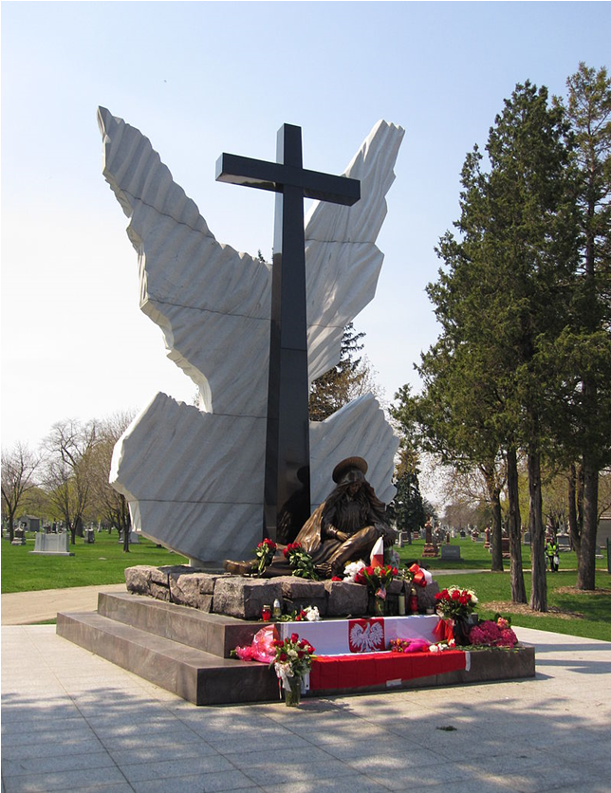
Chicago, Illinois, USA
Unveiled on May 17, 2009
Designed by Andrzej Seweryn
The monument was consecrated by the Primate of Poland, Cardinal Józef Glemp; the ceremony was attended by a representative of the Polish government, Witold Waszczykowski, who read a letter from the President of the Republic of Poland, Lech Kaczyński, to the participants in the ceremony.

Slide 46
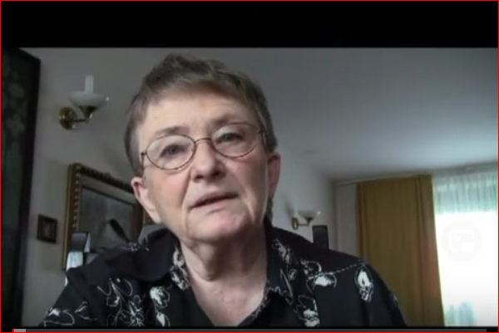
Witomiła Wołk-Jezierska, poet, daughter of an officer of the Polish Army murdered in Katyn in 1940, tells about the fate of her father and her family deported deep into Soviet Russia

Slide 47
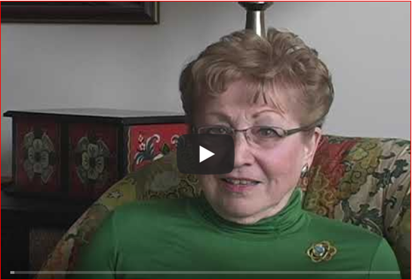
Janina Rychalska, daughter of a Katyn officer

Slide 48
The end
Questions?
Comments?
Family stories?

